Slide 1
TECHNOLOGY & DEVELOPMENT
ICT4D
WEEK 5-6

Slide 2
Let us pick up the thread- Development
Development is highly contested concept having wide ranges of meanings and connotations
In common parlance, it denotes a process of growth and progression towards betterment; a positive growth which is considered qualitatively good
It is a value judgemental concept, highly political and linked to power structure in society
Development as a discourse denotes various meanings getting assigned to the word development through narratives, speech, communication, language.
Dimensions of development- Economic, Social, Cultural, Political, Environmental, Human
Approaches to Development: Income Approach :Welfare, Rights Based, Capability, Sustainability
Human development: Increasing choices to have meaningful life: Health, Education, Resources
Alternate perspectives on Development: Marxian and Gandhian model

Slide 3

Let us pick up the thread- Globalization
Globalization is greater and faster interconnectedness of people, places, information, objects, activities, and exchanges across the Globe
May denote process, condition, structure, force, Policy, marketing strategy, predicament, an age.
Deep impact on all aspects of people’s life, academic disciplines, science, research, and technology
Alternative perspectives on its existence, extent, origin, key drivers, nature and impacts.
It is multi-faceted and Multi-dimensional
For globalists it has brought economic prosperity, democracies, equality, peace, human rights, global governance
For escapists, on both side of political spectrum, it adversely impacted local people, created greater inequality, served interest of ‘Haves’ of ‘the North’, environmental destruction, consumerism, socio-cultural turmoil
Its relationship with Development is mixed and Indeterminate

Slide 4
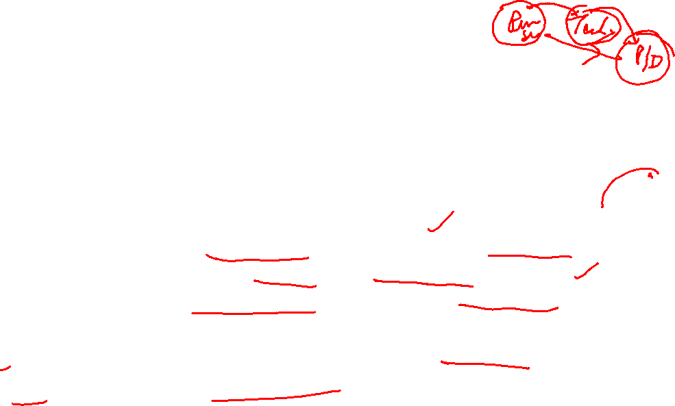
Technology: Meaning & Definitions
The application of scientific knowledge for practical purposes, especially in industry, for creating product/services/process or any other specific purpose
technology as a bridge between science and new products, products, systems, and services.“(Michael Bigwood in Research-Technology Management.)
“the use of science-based knowledge to meet a human need.“(J. Paap)
Thus, Technology is applying scientific knowledge to solve Societal problems.
Technology is used to: Produce goods or services, carry out goals, such as scientific investigation or sending a spaceship to the moon, solve problems, such as disease or famine.
technology is one of the most significant forces affecting business competition ( Michael Porter) technology-intensive and technology-driven world of business

Slide 5


Factors and events driving technological revolution- Centered in Europe
Scientific Revolution- 16th-17th century Europe
Enlightenment Movement: 18th century
Industrial revolution: 18-19th century

Slide 6
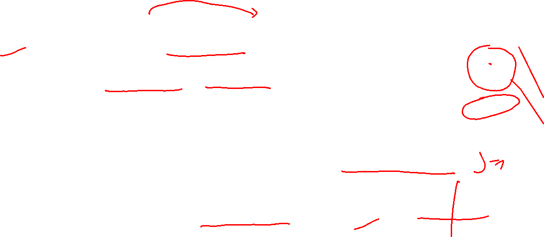
Scientific Revolution- 16th-17th century Europe
Replacing common sense by abstract reasoning & rationality
science had replaced Christianity as the focal point of European civilization.
Copernicus- 15th century- heliocentrism-sun at the centre of the universe;
Galileo Galilei- father of modern physics, Father of modern science
Kepler- Kepler's laws of planetary motion, elliptical orbits of planets
French philosopher René Descartes,17th century- analytical geometry, cartesian coordinate system, matter & motion ; Cogito, ergo sum- I think, therefore I am
Blaise Pascal- numerical calculator,
Newton, late 17th century- classical Mechanics, Gravity

Slide 7
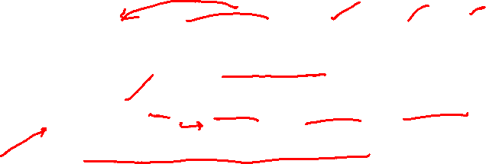

Enlightenment Movement: 18th century
Intellectual movement centered in France; it led to French Revolution
Objective knowledge based on science, reason, rationality
Enlightenment movement fundamentally changed how human live, think, relate, rule, and being ruled.
Science, not common sense, feeling, emotions, religion
Knowledge as objective truth, can be found by scientific method
Rule as social contract, not divine Right
Individualism, Humanism
Right of Liberty, Equality- Democracy- Rule of Law
Nation-state
Man controlling environment/nature

Slide 8
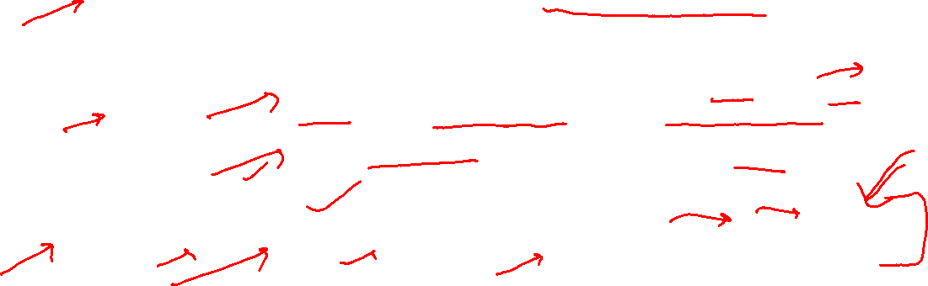

Industrial revolution: 18-19th century
Great invention and application of science for making life better. Human started to control and harness nature in big way
Industrial Revolution 1.0( IR1): Invention of the steam Engine in 18th Century
production was mechanized for the first time, driving social change as people became increasingly urbanized. Start of the Industrial Age
Industrial Revolution 2.0( IR2): 19th Century: Invention and use of Electricity, Telegraph and Telephone- Led to mass production, control from a distance, and many new products
Industrial Revolution 3.0( IR3): starting 1950s: Solid state electronics and Computing
ICT Revolution
Information and Knowledge Society
Industrial Revolution 4.0( IR4): fusion of advances in artificial intelligence (AI), robotics, the Internet of Things (IoT), genetic engineering, quantum computing, and more

Slide 9

Path breaking Technological Innovations & Inventions
Steam Engine- James Watt- 1765
Spinning mule- Samuel Crompton- 1779; Power Loom- Edmund Cartwright- 1785; The spinning jenny - James Hargreaves- 1770
Telegraph- Morse- 1844, Telephone- Graham Bell-1876
Electricity- Benjamin Franklin- 1752, Thomas Alva Edison- 1879
IC Engine- Motor car- Karl Benz(1879); Henry Ford- first time mass production of Cars
Air plane- Wright Brothers- 1902-03

Slide 10
Electronics-ICT- Path Breaking Inventions
Vacuum tube Diode- J.A. Fleming( 1897); a vacuum triode was implemented by Lee De Forest
Solid state transistor- William Shockley, John Bardeen and Walter Brattain- 1947
Micro-processor- Ted Hoff of Intel-1969;
TV- Philo Farnsworth- 1927
Computer- first personal computer, the Altair by MITS in 1974- used used Intel Corporation’s 8080 microprocessor
Mobile Phone- Martin Cooper- 1973
Internet- ARPANET- 1983
Email- Ray Tomlinson-1971
WWW- Tim Berners-Lee -1990
VoIP- 1995
Wi-Fi: 1997
Mobile Internet- 1999- NTT DoCoMo

Slide 11
Ongoing Technological Revolution in ICT
Artificial Intelligence( AI) and Machine Learning
Internet of Things (IoT)
Blockchain
AR, VR, Metaverse
Wearable internet
Web 3.0
Big Data Analytics
3D printing
Driverless Car
Genetic engineering
Quantum computing

Slide 12
Technology became the chief way by which Humans controlled its environment
Technological Revolution enabled Europe to modernise and Develop;
Through colonisation, technology led modernisation and Development was introduced in the 3rd World
Technology, especially ICT, became engine for current phase of Globalization

Slide 13
Technology and Development
Closely Linked, re-produce each other
Technology projected as secular, scientific, value-neutral, a-political, universal
Hence, technology led development is secular, scientific, value-neutral, a- political, and universal
Technology played both way
widened the gap between technology have and have nots
Helped poor & marginalised to leap frog
Technology led development was not sustainable- environmental destruction, resource exhaustion, global warming, climate change
Socio-cultural impact- mass society, anomie, individualism, loss of social and cultural capital, cultural homogenisation, Hegemony

Slide 14
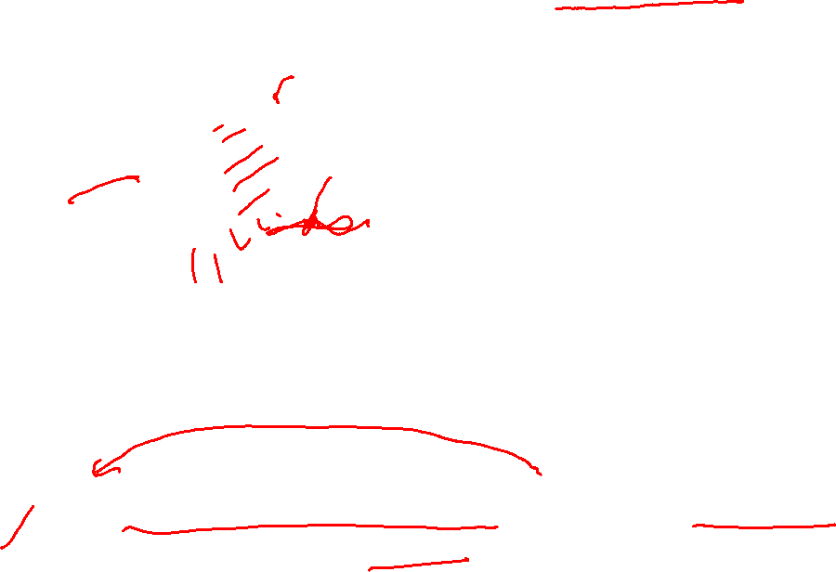
Development Globalization Technology- Seamless Web
Globalisation
Development
Technology
Globalization of American or western notion of development which is propelled by technology

Slide 15
Group Project Outline
Understanding the project
Why was this project developed
What are the objectives of the project?
What is the project context? (policy environment, socio-economic conditions, etc.)
What were the project processes ( assemblage of activities, methodologies and tools )
What are the strengths (e.g. resources and capacities available) and weaknesses (e.g. vulnerable conditions) of the project?
What are the external opportunities and threats that affect the project?
What is the expected results of the project?
What are the achievements and impacts? Were there any unintended consequences?
Understanding ICT4D through the Project
• Which perspective and approach of Development implicit in the project
Who were included and excluded?
Is the project replicable in other socio-economic contexts?
What social mechanisms would be required to be triggered for replicating the project in other contexts?
Source and References: Useful references for further information

Slide 16
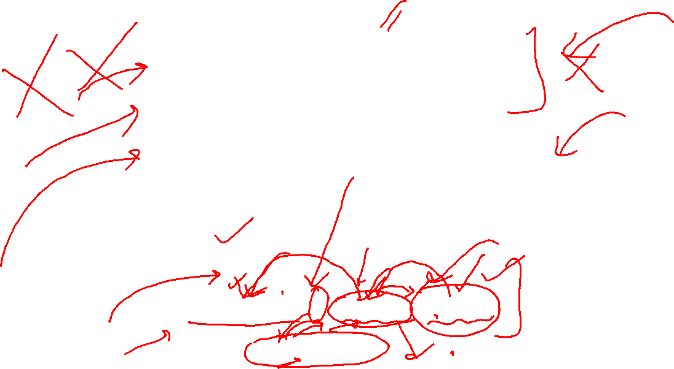
Reverse Engineering
FORWARD ENGINEERING – FIEST HAND EXPERIENCE
LEARNING FROM SECOND HAND EXPERIENCE
Outcome (O)= f( Process, Context)
F: Social Mechanisms

Slide 17
THANKS FOR LISTENING!
BE SAFE …GOOD WISHES !
https://forms.gle/j4JPW9pdEBYcGCMX6

